Slide 1
Visualization using BERT Sentence Embeddings
Chiayu Tu

Slide 2
Introduction to BERT
Importance of BERT in Natural Language Processing (NLP) tasks
Role of BERT in capturing contextual and semantic information in text data
Integration of BERT into the project for semantic sentence embeddings

Slide 3
Code Overview
Overview of the code structure
Importing necessary libraries
Initializing the SentenceTransformer model (BERT-based)
Defining a corpus of sentences for demonstration
Encoding the sentences into fixed-size vectors using the BERT model

Slide 4
Semantic Search
Explanation of semantic search functionality
Demonstration of finding similar sentences based on cosine similarity
Showcasing the query functionality and the top similar sentences retrieved
Highlighting the cosine scores indicating similarity levels

Slide 5
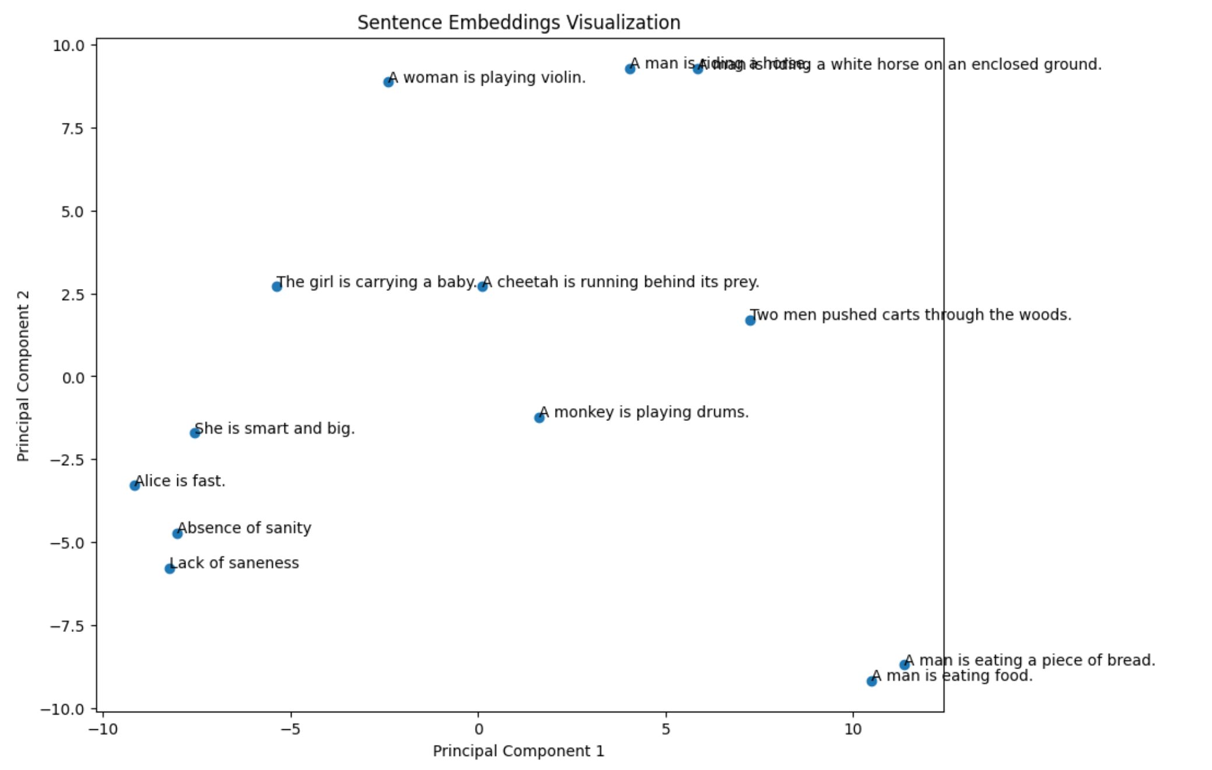
Visualization with PCA

Slide 6
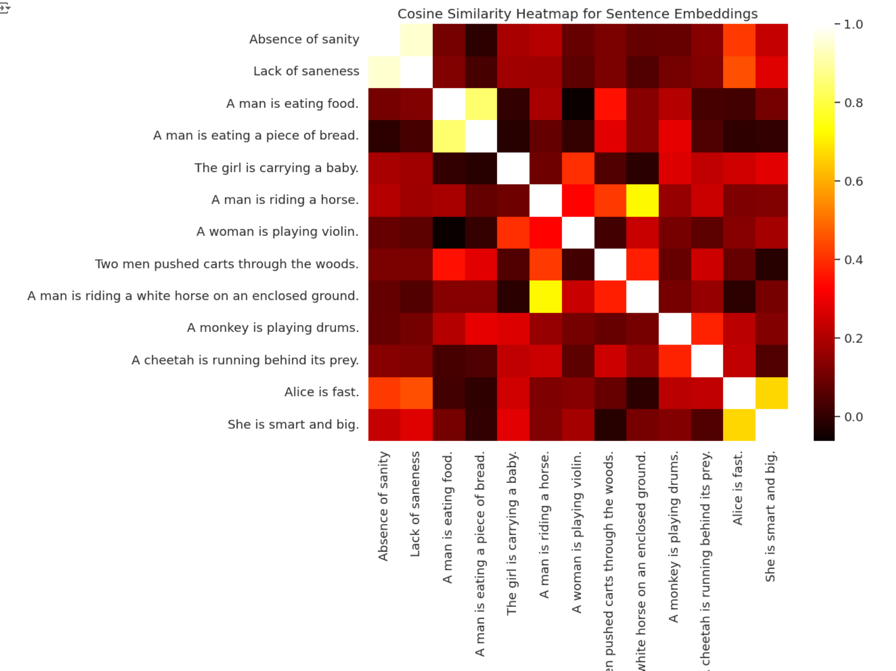
Heatmap Visualization

